Slide 1

Real Estate Finance FINM 3406 Week 3 – Tutorial 2
Prepared by : Rasheda Huda

Slide 2
1. Describe the general nature of “Property”.
Generally property rights is the right of a person to the possession, use, enjoyment, and disposal of his or her property.
When related to real estate, interest is a broad legal term used to denote a property right.
The holder of an interest in real estate has some right, or degree of control or use,
So they may receive payment for the sale of such an interest.
This interest, if its value can be determined, may also be bought, sold, or used as collateral for a loan.

Slide 3
2 What are the two main classifications of the “things” we call property?
Real Property (realty) and
Personal Property (personalty).

Slide 4
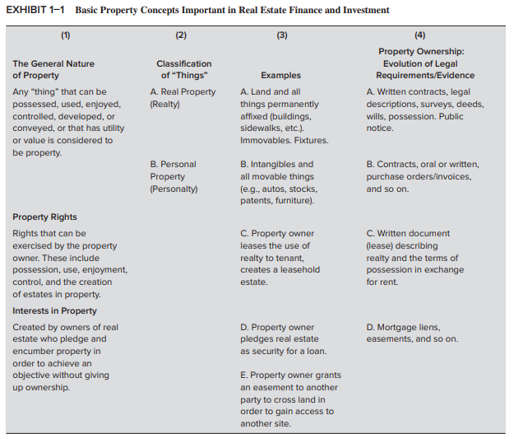

Slide 5
3. Can Real Property be intangible? If yes, provide some examples.
Yes.
Examples include:
Easements can be intangible.
Volumetric subdivisions.
Leasehold of airspace (eg Toowong Shopping centre and office tower and Sofitel hotel, Brisbane CBD).

Slide 6
4. What is meant by an “interest in property”?
A right in relation to realty.
An interest in property can be created by the owners of real estate who
may pledge and/or encumber their property
in order to achieve an objective without giving up full ownership.

Slide 7
5.What is the definition of an “estate” in the context of real property?
Estate means “all that a person owns.”
Real estate means all realty owned as a part of an individual’s estate.
Estates in real property is used to describe the extent to which rights and interests in real estate are owned.

Slide 8
A system of modifiers has evolved, based on English property law.
It describes the nature or collection of rights and interests being described as a part of a transaction.
For example, a fee simple estate represents the most complete form of ownership of real estate.
Leasehold estate usually describes rights and interests obtained by tenants when leasing or renting a property.
Leasehold is possessory interest and involves the general right to occupy and use the property during the period of possession.

Slide 9
6.Provide two examples of Freehold Estates.
Fee simple absolute in possession – a holder of a fee simple estate is free to
divide up the fee into lesser estates and
sell, lease, or borrow against them as he or she wishes,
subject to the laws of the state in which the property is located.
Life estate – this is a freehold estate that lasts only as long as the life of the owner of the estate or the life of some other defined person.

Slide 10
7.How do Freehold Estates differ from Leasehold Estates?
Estates in possession are of two general types:
freehold estates and
leasehold estates.
These types of estates are technically distinguished on the basis of the definiteness or certainty of their duration.
Notes:
Estates in possession are of two general types:
freehold estates and leasehold estates. These types of estates are technically distinguished on the basis of the definiteness or certainty of their duration. A freehold estate lasts for an indefinite period of time; that is, there is no definitely ascertainable date on which the estate ends. A leasehold estate, on the other hand, expires on a definite date. Aside from this technical distinction, a freehold estate connotes ownership of the property by the estate holder, whereas a leasehold estate implies only the right to possess and use the property owned by another for a period of time.

Slide 11
A freehold estate lasts for an indefinite period of time;
A freehold estate connotes ownership of the property by the estate holder,
A leasehold estate, expires on a definite date;
whereas a leasehold estate implies only the right to possess and use the property owned by another for a period of time.

Slide 12
8. What is the similarity between a Reversion and a Remainder?
They are both examples of a future estate.

Slide 13
9. What are the differences between a Reversion and a Remainder?
A reversion exists when the holder of an estate in land (the grantor) conveys to another person (a grantee) a present estate in the property
that has fewer ownership rights than the grantor’s own estate
and retains for the grantor or the grantor’s heirs the right to take back, at some time in the future, the full estate that the grantor enjoyed before the conveyance.

Slide 14
A remainder is the future estate (ie like a reversion)
but rather than returning to the grantor the future estate will go to a third person and not back to the original grantor.

Slide 15
10. Describe the Doctrine of Tenure and explain why it still applies today in Australia?
The Doctrine of Tenure is a legal principle that originated in medieval England and is still applied in Australia today.
It refers to the concept of land ownership and tenure, meaning that individuals or groups who own land- hold it by way of a grant from the Crown
(the “Crown” is now referred to as the “State”).

Slide 16
Under the Doctrine of Tenure,
land ownership is based on a hierarchical system, --monarch or ruler is considered the ultimate owner of all land in the kingdom or country.
All other landowners hold their land as a form of tenure, meaning they have certain rights and obligations attached to their ownership.
For example, they may owe taxes or
military service to the monarch in exchange for their landholding.
Notes:
These historic feudal obligations associated with a grant (such as service) have been abolished, other obligations such as the payment of money (ie rates and land tax) remain.

Slide 17
In Australia, the Doctrine of Tenure is still applied in a modified form,
due to the laws associated with recognizing Native Title, the Crown in Australia only has a radical title
(it can take ownership of the land and grant it to people but it did not obtain absolute sovereignty over all of the lands and waters of Australia upon settlement on 26 January 1788 – native title may still exist).

Slide 18
Under Australian law, the granting of land by the Crown (ie the State) is a right that remains with States not the Commonwealth.
While the Doctrine of Tenure may seem outdated, it still applies in Australia.
Notes:
today because it remains an active and effective component of the legal system we inherited from the British upon settlement.

Slide 19
It provides a legal framework for land ownership and use.
It provides a mechanism for spatial allocation of land (ie one parcel of land comes from the Crown to the grantee, who in turn can grant that to someone else and so on).
The Doctrine of Tenure can be contrasted with the Doctrine of Estates which applies a temporal allocation of land tenure that has been granted.

Slide 20
11. What are the three sources for rights and obligations under a lease?
Written contract (primary source of rights and obligations between the parties).
Part VIII of the Property Law Act 1974 (QLD):
s 105 – tenant’s obligation to pay rent, keep in repair etc.
s 107 – landlord’s right to enter, repair etc
Common law – implied terms and conditions:
Tenant right – quiet enjoyment
Landlord obligation - non derogation of grant

Slide 21
12.What are the main differences between a lease and a licecse ?
A lease creates both property and contractual rights for the lessee.
A licence only creates contractual rights for the licencee.
The lessee’s rights in relation to their use of the property can be enforced against the world at large.
A licencee can only enforce rights in relation to their use of the property can be enforced against the licensor.
A lease can be assigned by the lessee to a third party (subject to express provision in the lease prohibiting/restricting this).

Slide 22
A licence cannot be assigned (unless it is associated with a lease – eg carparking licence as part of a retail lease).
A lease grants exclusive possession of a premises (a licence is non-exclusive).
WHY THIS MATTERS –
it impacts your security of tenure if you need to occupy a property (ie leases is better than licences) and makes your income stream as an investment less secure.

